Slide 1
Modern Application and API development
Module – 01
Class-06
CSS-03
Saylani Mass IT Training Faisalabad

Slide 2
CSS Box Model
Content
Padding (Area inside the element)
Margin (Area outside the element)
Border

Slide 3
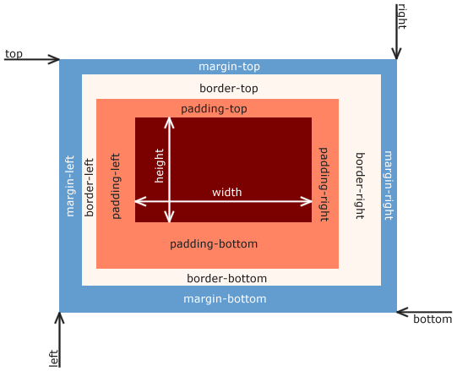

Slide 4
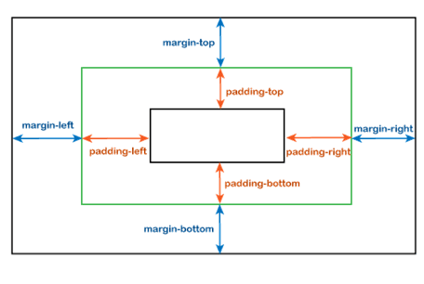
Padding and Margin

Slide 5
Padding
Padding is used to create space around an element's content, inside of any defined borders.
Padding-top
Padding-right
Padding-bottom
Padding-left

Slide 6
Margin
Margin used to create space around an element's , outside of any defined borders.
Margin -top
Margin -right
Margin -bottom
Margin -left

Slide 7
Border
The CSS border properties allow you to specify the style, width, and color of an element's border.
Border(width ,color , style)
Clockwise: top right bottom left
Border Radius (top ,right ,bottom , left)

Slide 8
Text Formatting
Text-align
Text decoration (line style color)
Text-indent (only for 1st line)
Text-transform
Text-shadow
Word spacing
Letter spacing

Slide 9
Fonts
Font Size
Font Family
Font weight
Font Family

